Slide 1


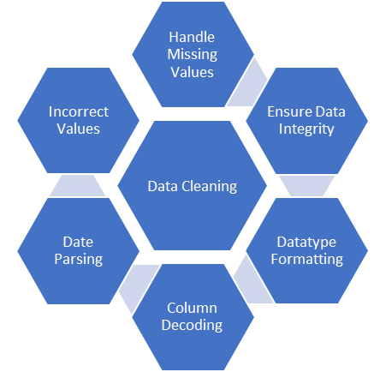




Data Sources
Pull csv extract files
Stack and concatenate datasets that are in multiple files
Data cleaning cycle
Join each dataset on date index column

Slide 2





Data Sources

